Slide 1



Slide 2
Copy URL into browser to play intro video
https://cognizant.kpoint.com/app/video/gcc-2b27e004-2e07-4bbb-bf70-674475c7cbc2

Slide 3


Go-Live: 16th January, 2018
One Stop Portal for all Learning Needs
From ELT to ELT
CAMPUS HIRE
SKILLING
YEAR 1 LEARNING
LEADERSHIP DEVELOPMENT
COGNIZANT CAREER ARCHITECTURE
MERGERS & ACQUISITIONS
ONBOARDING LATERAL
SALES EXCELLENCE
Notes:
Cognizant Academy is a partner to the associates right from the Campus Hire stage to their growth through CCA, all the way upto Leadership Development. It also supports onboarding of Laterals, M&A, Sales Excellence training and Skilling needs of various Business Units as and when the need arises.
Whether it is a campus hire, a veteran Practice Lead, an Instructor, or a Delivery Head who is looking for quick skilling, Cognizant LEARN will play a central part in their experience.

Slide 4
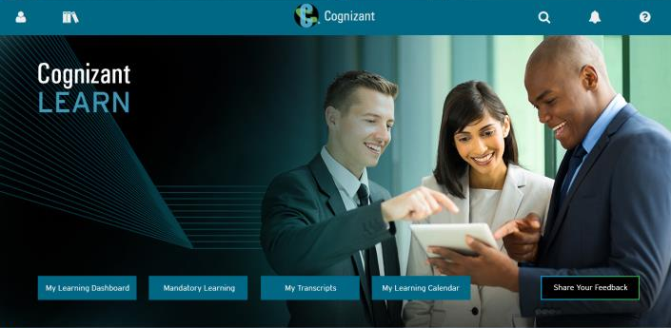








Here’s what Cognizant LEARN has to offer
Personalized Learning Paths
Learner Dashboard
Cloud Deployed
Collaborative Learning Ecosystem
Single-click
access to
information
and actions
Intuitive navigation and workflows
Mobile and Social capabilities
Enterprise Search
Accessible
anywhere
Robust
reporting
and analytics
Seamless Integration
Multi
Lingual
Notes:
Here’s what Cognizant LEARN has to offer:
Personalized Learning Paths
Empowers associates with tools that connect learning to critical developmental and performance needs. Equips our associates with their own curated content aligned to their role development plans (RDPs).
Learner Dashboard
Visual timelines of priorities and tasks and individualized insights into learning progress that help associates track their role readiness and RDP completion progress.
Cloud Deployed
Hosted in high resilience cloud environment, the platform gives our associates responsive access from anywhere around the world through office network or through internet.
Collaborative Learning Ecosystem
Empowers informal learning by providing learners a complete set of tools and communities of practice to collaborate with and to share knowledge around any topic or activity. Provides social platform for agile creation of content by subject matter experts.

Slide 5


What is Changing
1
One stop portal for all learning needs
6
Seamless integration with MyCareerApp and RDP
2
ELM, My Learning, Skill port , RDP app to be sunset
7
RDP submission step no longer needed
3
Tighter controls on WebEx sessions pre-registration
8
BPS REC now available as RDP
4
User friendly list based UI
9
Improved ease of access to instructor feedback
5
RDP completion updates every 4 hours

Slide 6
Important dates to note
10th January, 2018
Completion of all online learning in ELM
Registered / In progress programs/ packages status is not migrated. Learners to search and re-register in Cognizant LEARN.
11th January (5:00 AM IST | 12:30 AM CET | 10th January – 3:30 PM PST) to 15th January, 2018
ELM shutdown for migration and cutover to Cognizant LEARN
16th January, 2018
Cognizant LEARN to go live. All online learning to resume.
22nd January, 2018
Classroom sessions, Virtual classroom / Webinars and Assessments to resume.

Slide 7

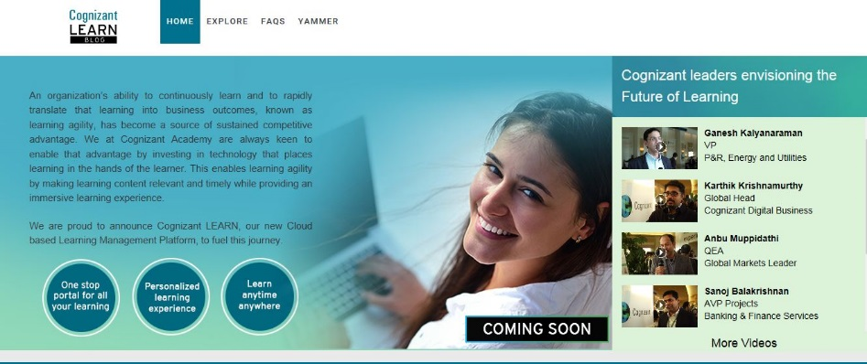


Personalized Communication
Announcements, updates and learning resources
From the FutureOfLearning2@cognizant.com mailbox
Cognizant LEARN Blog
https://blogs.cognizant.com/cognizantlearn/
Info / Updates / FAQs / How To Videos
Cognizant LEARN Yammer Page
Info / Updates
Click Here to Visit

Slide 8


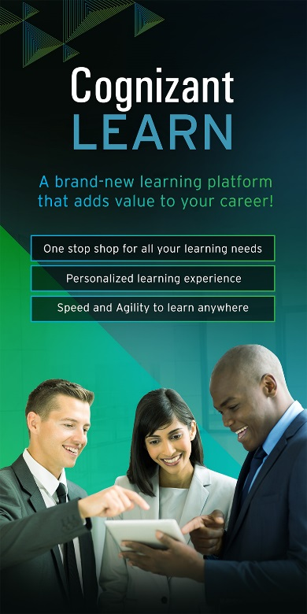

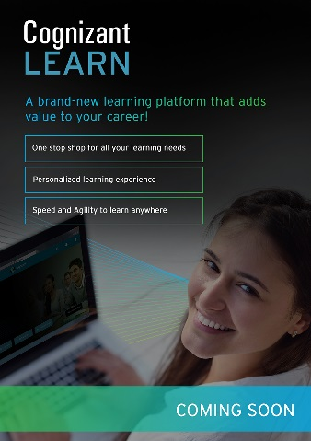
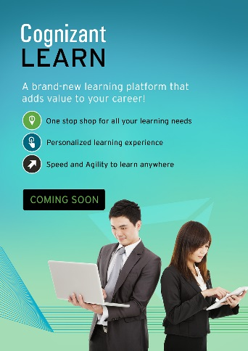


Big Bang Communication
Desktop Wallpapers
Jan 16th
1C Home Page Popup
Danglers
Posters
Cafeteria Video
Standees

